Slide 1
Vibration isolation
31st August 2017

Slide 2
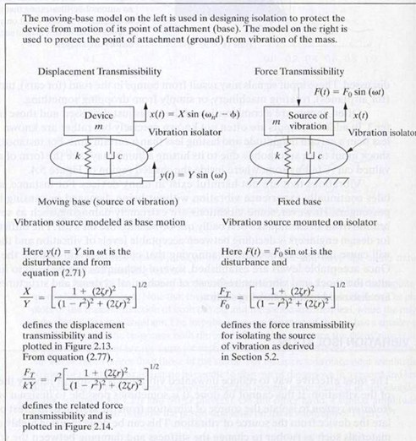
Vibration isolation
Generally, the vibration isolation can be divided into to two basic types ; i.e.,
(1) displacement isolation and (2) force isolation.
The moving-base model on the left is used in designing isolation to protect the device from motion of its point of attachment (base).
The model on the right is used to protect the point of attachment (ground) from vibration of the mass.
http://slideplayer.com/slide/8032841/

Slide 3
Problem on displacement vibration insulation
y = vertical displacement of the base about its rest position.
x = vertical vibration of the floor about its equilibrium position
Requirement :Protect sensitive objects (i.e. heavy base) from vibrating floors and foundations.
Target : The ratio y/A is kept to a minimum.
Notes:
The idea is simple: Protect sensitive objects from vibrating floors and foundations. So is the basic vibration-isolation system model,
The spring resists the movement of the vibration because it exerts an opposing force proportional to its displacement.
The damper consists of a piston moving through a viscous fluid, or a conductor moving in a magnetic field, and it removes kinetic energy and dissipate it as heat.

Slide 4
Problem on displacement vibration insulation (cont.)
Equation of motion
Suppose y > x;
Suppose
Determine the derivatives of y and x and substitute in the equation of motion.
This ends up in terms of the magnitude ratio as follows,
Notes:
y-x เป็นระยะกระจัดสัมพัทธ์ ของตัวถ่ายทอดการสั่นซึ่งประกอบด้วย sprint และ damper
dy/dt – dx/dt เป็นความเร็วสัมพัทธ์ของตัวถ่ายทอดการสั่น

Slide 5
Physical meaning of the ratio |y/A|
What does it mean if the magnitude ratio is greater than 1?
Under the condition, this is found that or
Notes:
Isolation is the reduction in transmitted vibration through the storage and controlled release of vibrational energy.
The figure shows the effect of adding damping to a spring mass system. In many cases, it is impossible to add enough damping to reduce peak transmitted vibrations to acceptable levels. Therefore, the system engineer must ensure that the natural frequency of the system is sufficiently below the disturbing frequency so the transmitted vibrations are minimized.

Slide 6
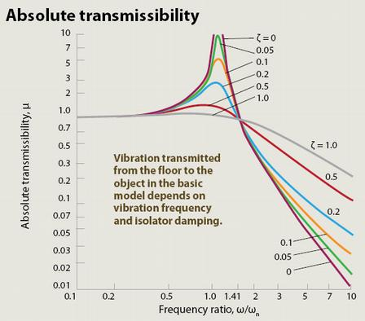
Displacement
Transmissibility |y/A|
The displacement vibration isolator will generally operate at the mass controlled end of the frequency spectrum and the resonant frequency is designed to be lower than the range of frequencies likely to be met.
http://machinedesign.com/archive/shaking-vibration-models
Notes:
Isolation is the reduction in transmitted vibration through the storage and controlled release of vibrational energy.
The figure shows the effect of adding damping to a spring mass system. In many cases, it is impossible to add enough damping to reduce peak transmitted vibrations to acceptable levels. Therefore, the system engineer must ensure that the natural frequency of the system is sufficiently below the disturbing frequency so the transmitted vibrations are minimized.
ข้อมูลเพิ่มเติมคือ ในกรณีที่เราไม่สามารถปรับเปลี่ยนเกี่ยวกับ isolator ได้แล้ว กล่าวคือ เปลี่ยน natural frequency เพื่อให้ operating frequency มาอยู่ใน isolation mode
เราก็สามารถลด transmissibility ได้ (ลด transmissibility เท่ากับลด energy transfer ที่จะไปยัง structure ที่เราไม่ต้องการให้มันสั่น) ได้ด้วยการเพิ่ม damping ratio ζ

Slide 7
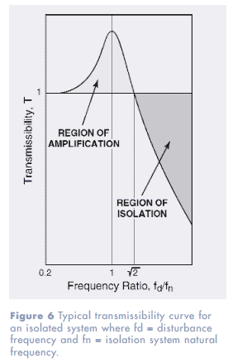
Analysis of the displacement transmissibility
From the displacement transmissibility the object vibrates less than the supporting surface of vibrating frequency if vibration frequency (region of isolation).
Lower-stiffness vibration isolators decrease the natural frequency ω₀ and transmit less vibration to the object.
The increasing isolator damping reduces an object’s vibration amplitude at by lessens isolation at (region of amplification).
http://www.novibration.com/isoselectguide.htm
Notes:
Because ω₀ ^2 = s/m, s↓ then ω₀ ↓

Slide 8

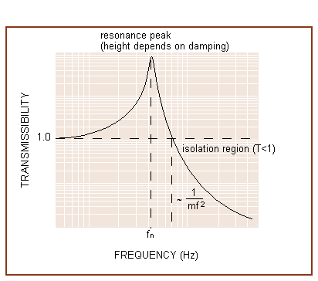
Animation of displacement vibration isolator
https://www.thorlabs.com/tutorials/tables5.cfm

Slide 9
Displacement transmissibility in terms of damping ratio ξ
By definition, the damping ratio ξ is given as the ratio of the damping factor to the critical damping factor,
This leads to
Therefore, the transmissibility in terms of ξ is written as

Slide 10
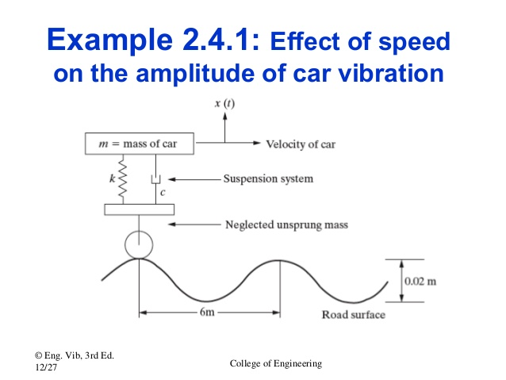
Problem : Effect of speed on the amplitude of car vibration
y(t)
Given
(1) car speed = 20 km/hr
(2) car mass = 1007 kg
(3) stiffness s = 4 x 10⁴ N/m
(4) damping constant r = 2000 Ns/m
Determine the amplitude response of the car to the vibrating road surface by considering the surface disturbance in the form of a sinusoidal input.
20 km/hr
s
r
http://www.slideshare.net/SondiponAdhikari/base-excitation-of-dynamic-systems
Notes:
Damping constant ค่าคงตัวของการหน่วง

Slide 12
Force vibration isolation
The vibration source is mounted on isolator composed of a spring with stiffness s and a damper with damping constant r .
The mass is disturbed by a force F(t).
What is the force transmissibility for isolating the source of vibration?
s
r
http://slideplayer.com/slide/8032841/

Slide 13
Force vibration isolation (cont.)
Equation of motion of mass m is given by
The solution as the displacement is written as
This can be written in terms of ξ, ω and ω₀ as

Slide 14
Force vibration isolation (cont.)
The response of the supporting base is due to the force combination of spring with stiffness s and damper with damping constant r .
By substituting x from the previous slide and determine the force transmissibility,
A = vibrating amplitude of the base

Slide 15
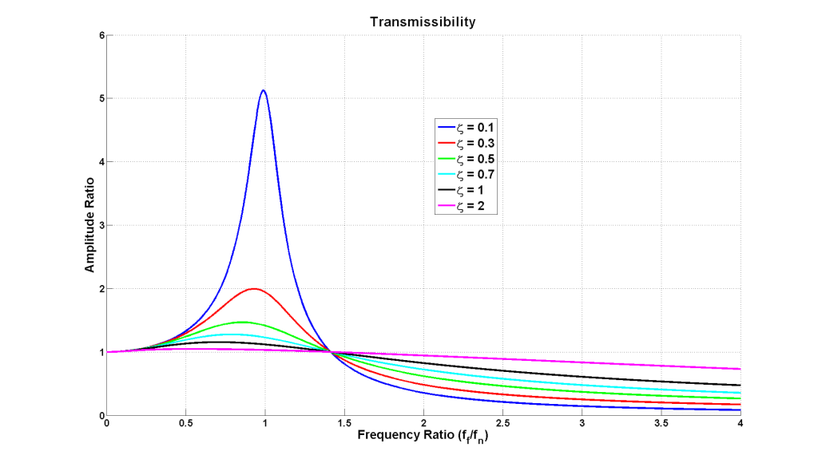
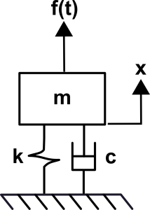
Force transmissibility curve
http://www.kaztechnologies.com/faq/
Notes:
What is transmissibility?
Transmissibility is another concept that summarizes particular behaviors of a mass, spring, damper system. It is the steady state amplitude ratio of output to input for a given frequency ratioand damping ratio. This amplitude ratio can be expressed in whatever units are of interest and most often will used as a measure of force transmitted or displacement transmitted. Transmissibility is a key concept to vibration isolation. One example of using this concept with respect to force is evaluating how a vibrating piece of equipment transmits force to the structure of a building and how this can be manipulated and reduced. A second example that would be concerned with transmitted displacement would be isolating sensitive equipment from a vibrating environment. Both of these concepts can also be extended to cars and race cars. The transmissibility plot below shows how amplitude ratio behaves as a function of frequency ratio for variousdamping ratios

